Slide 1
Back To My Mac (BTMM)
Husam Alzaq Kahlan Faiq Fariba Khameneh
March 2017

Slide 2
Agenda
What is BTMM ?
How does it work?
Is it a mobility Solution ? If so , How ?
Notes:
In this pres. We would like to present the main information about BTMM (what it stands for ,the way it works and , and whether it solves the problem of mobility or not and how

Slide 3
What is Back To My mac (BTMM)
An engineering approach to mobility support
MAC OS leopard X 10.5 , October 2007
Host mobility solution , end-to-end data Delivery
Combination of several protocols
Secured transport connection
File and Screen sharing
Continuous communication while hosts move
Notes:
I suggest to write the protocol names so that the student can understand it
For example IPSec …. Etc.

Slide 4
Mobile IP Solutions
Layer | Solution
Application Layer | SIP Back to my Mac BTMM
Transport Layer | mTCP
IP Layer | LISP Tunneling
Data Link layer

Slide 5

How does it work?
Requires at least two MACS ,Apple ID
UPnP / NAT – PMP
IPv6 Unique Local Address (ULA) as host identifier
IPsec to secure data comm.
Kerberos for end-to-end authentication
IPv6 socket interface
IPsec Encapsulation Security Payload (ESP)

Slide 6
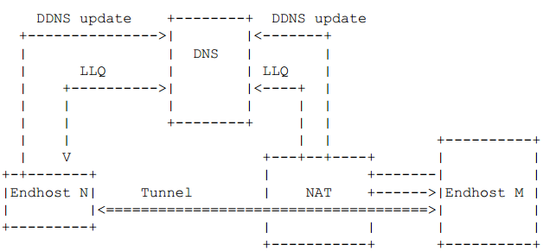
Is it a mobility solution and how ?
DNS_SD for host reachability info& mapping service
Long _ Lived Queries(LLQs) for notifying hosts
2
3
1
4
Notes:
I added some steps to enhance the presentation
Good luck

Slide 7
Thanks for your patience

